Slide 1
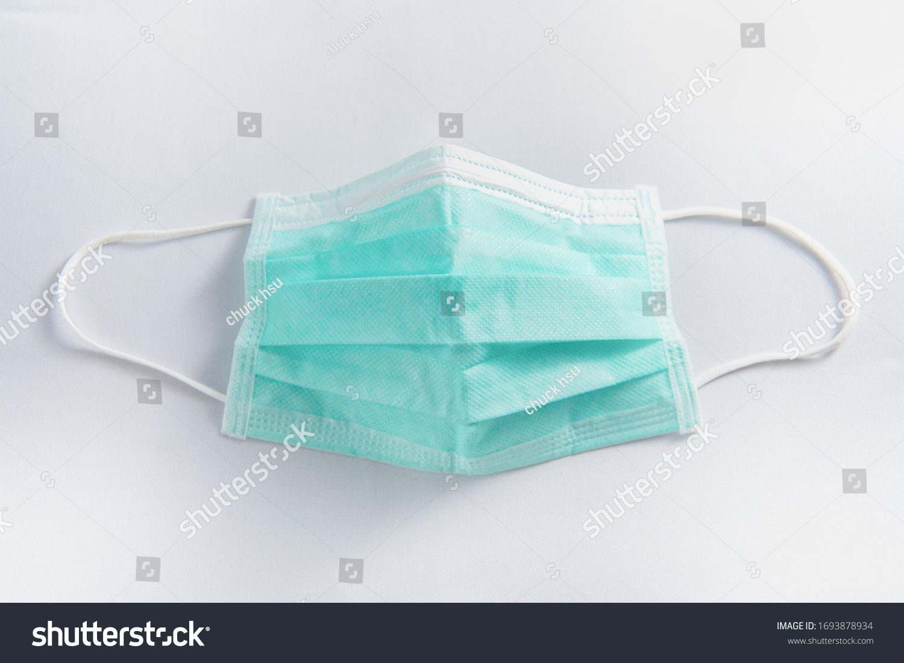
FACE MASK DETECTION USING CONVOLUTIONAL NEURAL NETWORK
PRESENTED BY: REENA S
REGISTER NO: 312208993
DEPARTMENT: COMMERCE

Slide 2
INTRODUCTION
Public use of face masks has been common in China and other nations in the world since the beginning of the new coronavirus disease outbreak.
We now know from recent studies that a significant portion of individuals with coronavirus lack symptoms (“asymptomatic”) and that even those who eventually develop symptoms (“pre-symptomatic”) can transmit the virus to others before showing symptoms, according to the advisory published by the Health Centre.
Nobody can keep an eye on every person coming in the work space is wearing a mask or not.
So the need of Face mask detection arose. The model in this paper uses the Convolutional Neural Network.

Slide 3
RELATED WORK
They have proposed a pre-trained MobileNet with a global pooling block for face mask detection.
The pre- prepared MobileNet takes a shading picture and creates a multi-dimensional component map.
The worldwide pooling block that has been used in the proposed model changes the element map into an element vector of 64 highlights.
At long last, the softmax layer performs paired order utilizing the 64 highlights. We have assessed our proposed model on two openly accessible datasets.
Our proposed model has accomplished 99% and 100% exactness on DS1 and DS2 separately.
The worldwide pooling block that has been utilized in the proposed model dodges overfitting the model.

Slide 4
PROPOSED SYSTEM
The model proposed here is designed and modeled using python libraries namely Tensor flow, Keras and OpenCV.
The model we used is the MobileNetV2 of convolutional neural network. The method of using MobileNetV2 is called using Transfer Learning.
Transfer learning is using some pre trained model to train your present model and get the prediction which saves time and makes using training the different models easy.
We tune the model with the hyper parameters : learning rate, number of epochs and batch size.
The model is trained with a dataset of images with two class, with mask and without mask.

Slide 5
RESULTS
We have tested the model for different scenarios, below mentioned is the table with the results of those scenarios with number of epochs 20 and batch size 32 constant for all the three situations.
We have used Average Pooling for capturing smooth image.
Also the validation accuracy is higher than the training accuracy which proves that the model is not suffering through overfitting

Slide 6
FUTURE WORK
The present model proposed gives great accuracy for single face with and without mask. For multiple faces also it gives quite good accuracy.
It works easily on any mobile device just by switching on the video stream, with no external hardware requirement.
Further we will work for improving the accuracy for multiple face mask detection, to classify the faces into three categories that is, With mask, without mask, Improper mask instead of just the two with and without mask class by adding datasets with images of people wearing masks not covering their noses properly and also to detect the masked face using the Face Net model of Convolutional Neural Network.

Slide 7
CONCLUSION
To moderate the spread of the COVID-19pandemic,measures should be taken.
We have demonstrated a facemask detector using Convolutional Neural Network and move learning techniques in neural organizations.
To train, validate and test the model, we utilized the data set that consisted of 993 masked faces pictures and1918exposed faces pictures.
These pictures were taken from different assets like Kaggle and RMFD datasets.
The model was induced on pictures and live video transfers.To choose a base model, we assessed the measurements like precision, accuracy, and recall andchoseMobileNetV2 architecture with the best exhibitionhaving99% precision and 99%recall.
It is additionally computationally efficient using Mobile.

Slide 8
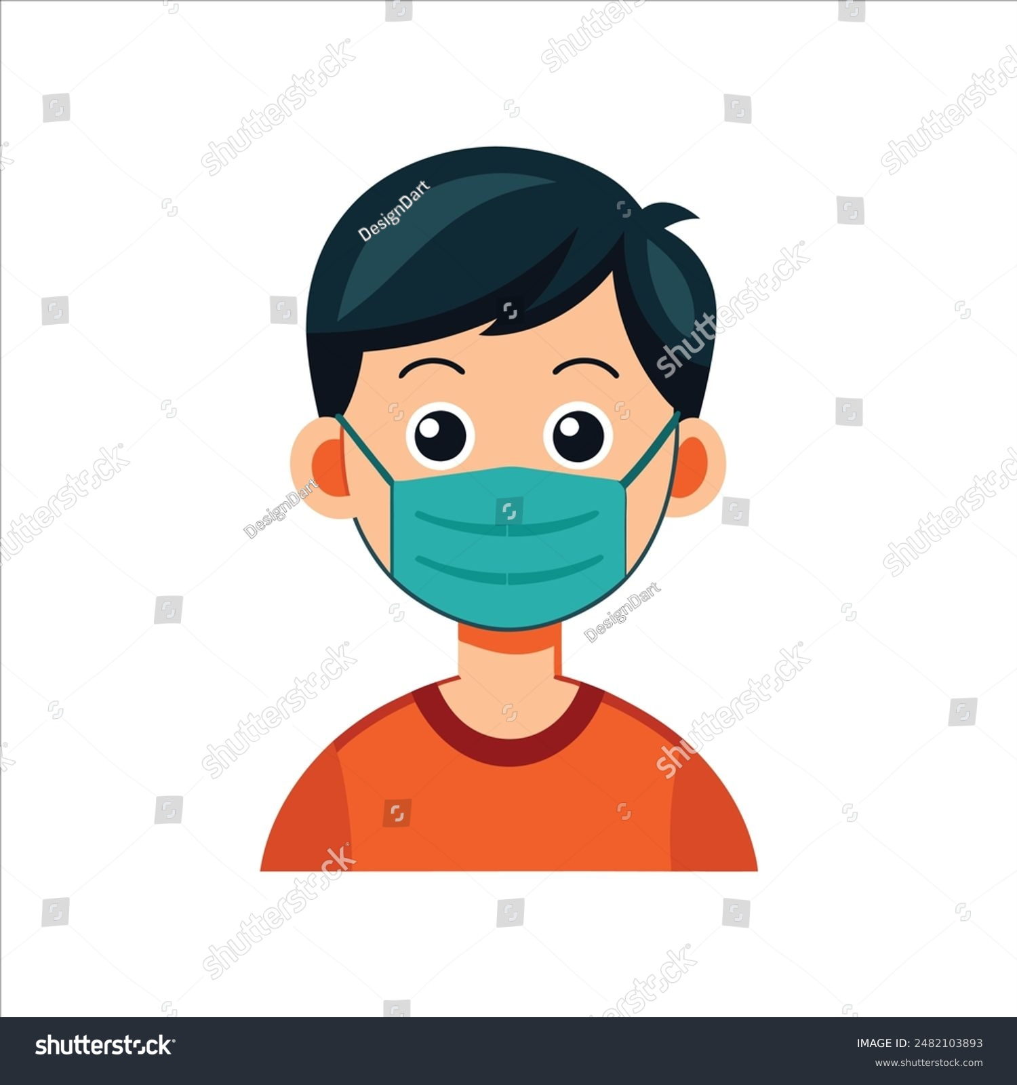
THANK YOU

